Slide 1

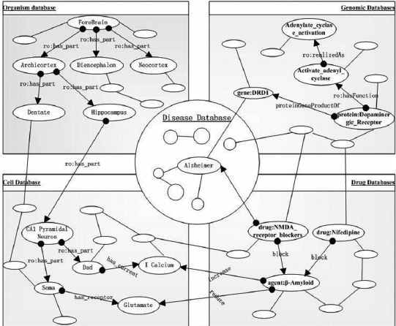
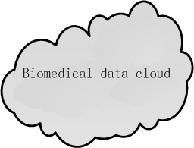

OWL Reasoner
Rule1
Rule2
Rule3
…
Rule base
Semantic network
……..
Hadoop clusters

Slide 2
Cell database
Organism database
Biomedical Knowledge Graph
Target
database
Symptom database
Semantic Modeling
Gene Product
database
Relation Extraction
Drug database
Disease
database
Protein
database
Rule1
Rule2
Rule3
...
OWL Reasoner
Chemical Component
database
Gene
database
TCM database
……..
Distributed Reasoning System
Biomedical Data Cloud

